Slide 1
Wednesday
27 October
2021
Career Development Beyond Job Titles

Slide 2
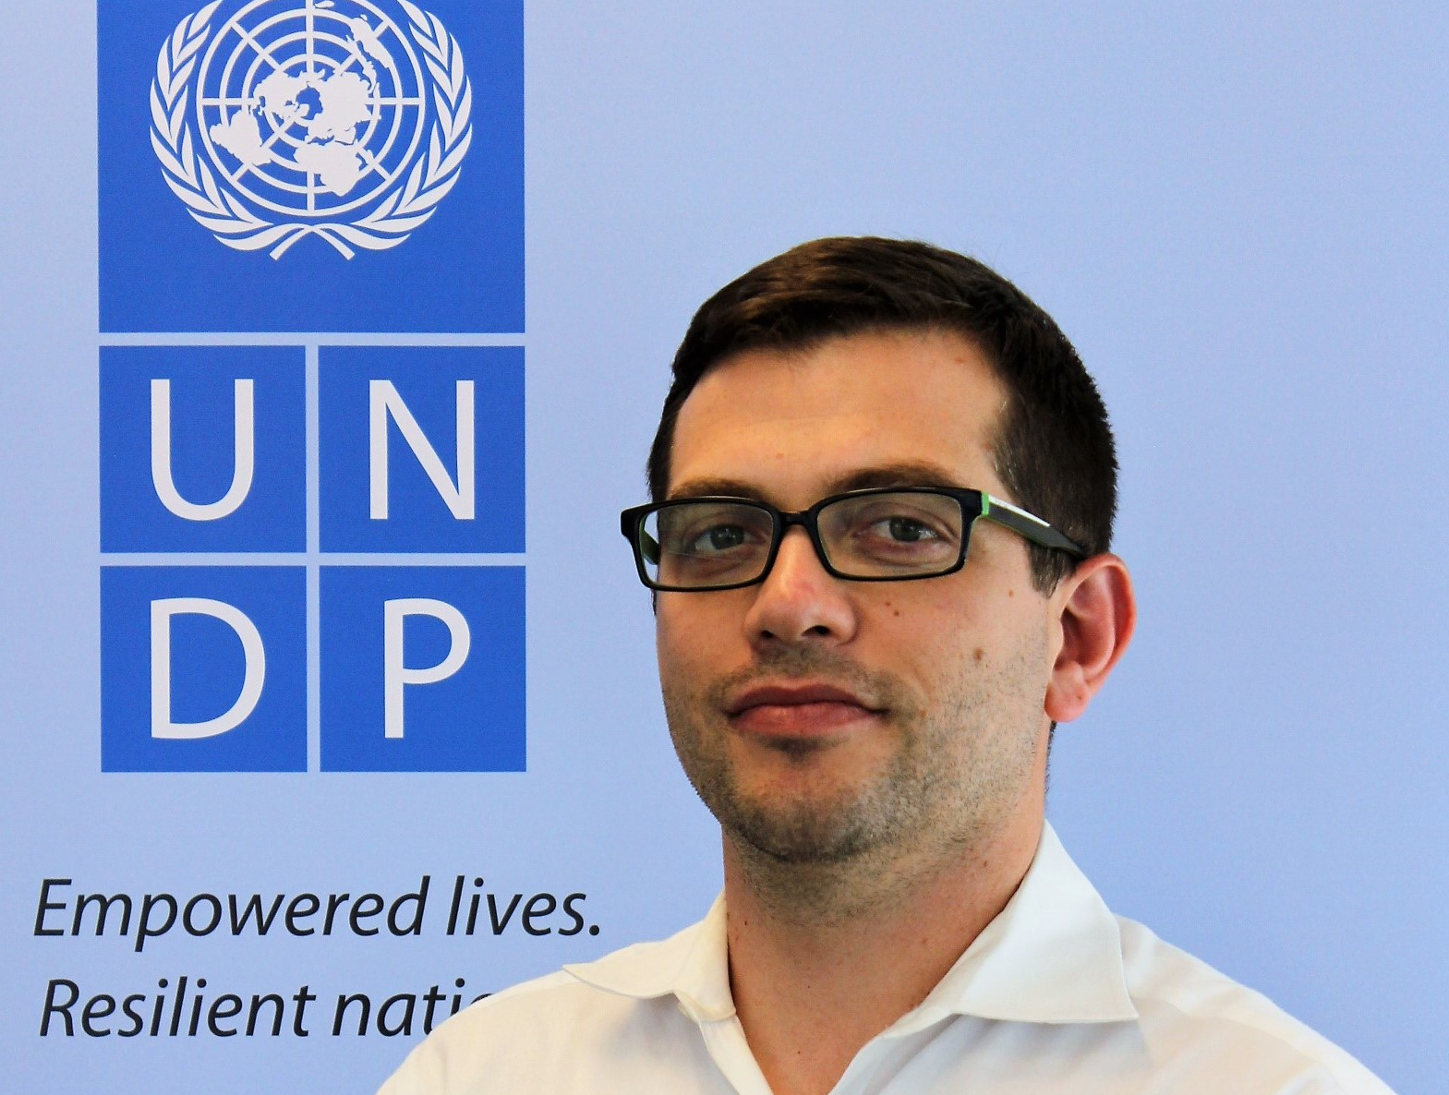
Your Host Today…
Pierre Noel
Manager, Career Development & Experience

Slide 3
Antoinette Oglethorpe
>25 years of experience developing leaders in the Private Sector and now consulting with the UN System
- Speaker and Author on Talent Development
- Professional Career Coach and Counsellor
“[Career Conversations] provoke reflection insight, ideas and action. They keep the focus on the employee while helping them see things differently. And they encourage them to take ownership of their own development. They help them recognize possibilities.”
Antoinette Oglethorpe in “It’s Good to Talk - A Practical Guide to Have Career Conversations in the Workplace.”

Slide 4
Poll
How many job titles do you know?
2
20
200
2000
20000

Slide 5
As a result of this webinar, participants will:
Consider how important job titles are in the real world of work
Identify how they can live beyond job titles to focus on things that are important to them
Understand what the Challenge Mindset is and how to apply it to their own career development activities

Slide 6
What We’ll Cover in this Webinar
Job Titles. How important are they?
Living Beyond Job Titles. Aligning what you do with purpose and meaning
The Challenge Mindset. Shifting your focus from job titles to challenges

Slide 7
Job titles. How important are they?

Slide 8
Question
Does your current job title REALLY reflect the work do?
Please type your answers into the chat box

Slide 9
Why we think job titles are important
Job titles seem to matter because of how they are perceived:
Your job title explains your role in the organization
It defines your position in the organiszation relative to others
A change in your job title indicates that you’ve taken on new and increased responsibilities
Your job title impacts how much money you make

Slide 10
Living in a Box
“So, what do you do?”
“Oh, I’m a Talent Development Analyst for UNDP.”

Slide 11
Disempowering beliefs and thoughts
Self-worth and perceived status
Coping with change
Adding value to the organization
How the organization sees you
Differentiating yourself
How you experience life

Slide 12
Perceptions of job titles are NOT reality
Misleading titles
Company variations
Changing landscape

Slide 13
Reflection
How are you limiting yourself by focussing too much on your job title?

Slide 14
Living beyond job titles. Aligning what you do with purpose and meaning

Slide 15
Question
How would you describe the work you do without a job title?
Please type your answers into the chat box

Slide 16
#1 Have a vision and/or purpose for yourself
For example, “to be well-respected”

Slide 17
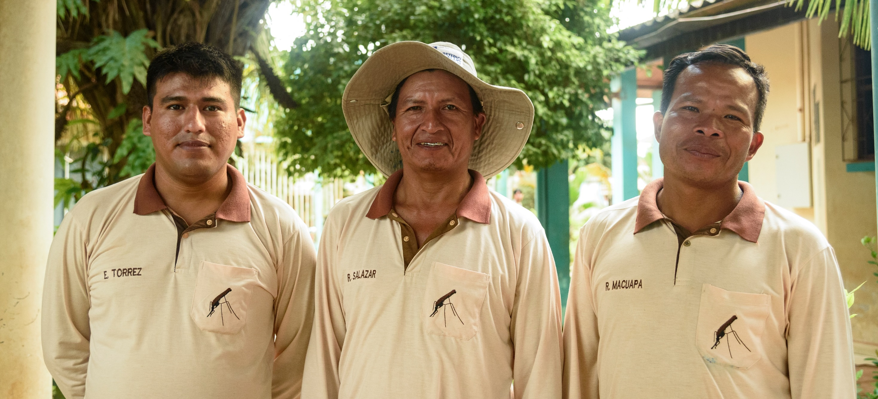
#2 Set goals in all aspects of your life
family
finance
health
personal
growth
spiritual
lifestyle
pleasure
legacy

Slide 18
#3 Have a plan
With sub-goals and milestones to track your progress

Slide 19
#4 Conduct a skills audit
What skills do you have, what skills do you need to achieve your goals and what is the gap?

Slide 20
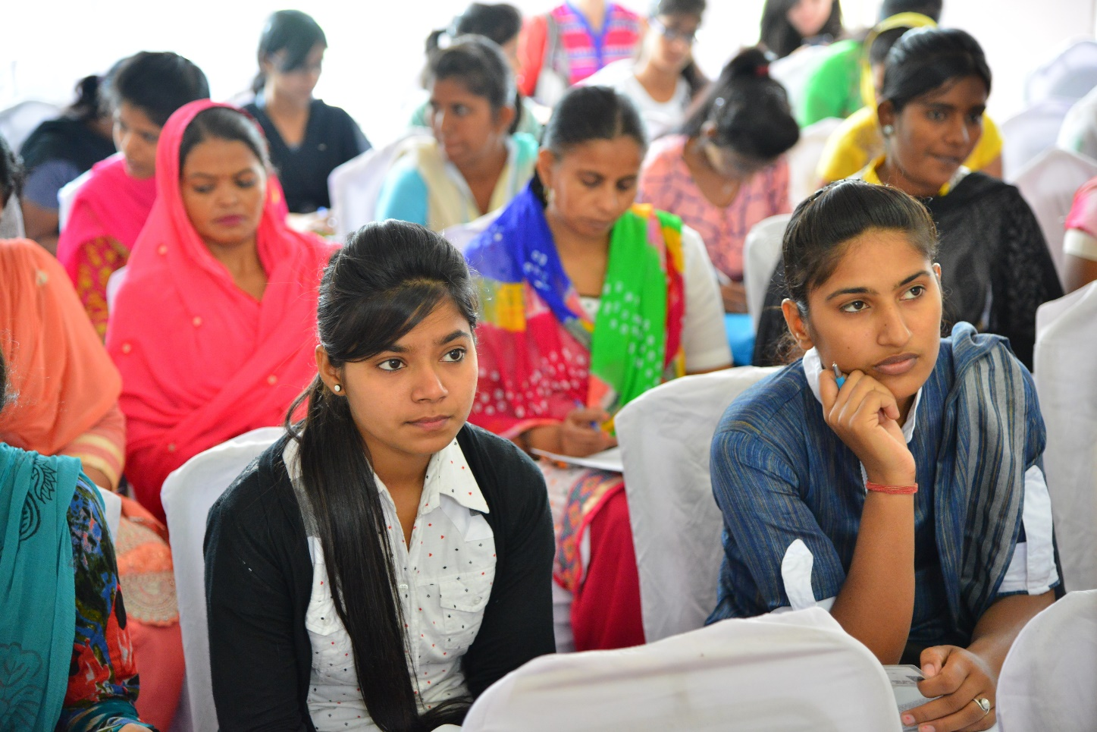
#5 Consciously develop your skills
Attend courses
Get coaching
Observe others
Read books
Search the internet

Slide 21
#6 Promote your skills, abilities, interests and goals
Share your goals with others,
the development you are undertaking or
the additional experience you have

Slide 22
#7 Take opportunities to work on projects
Put your hand up

Slide 23
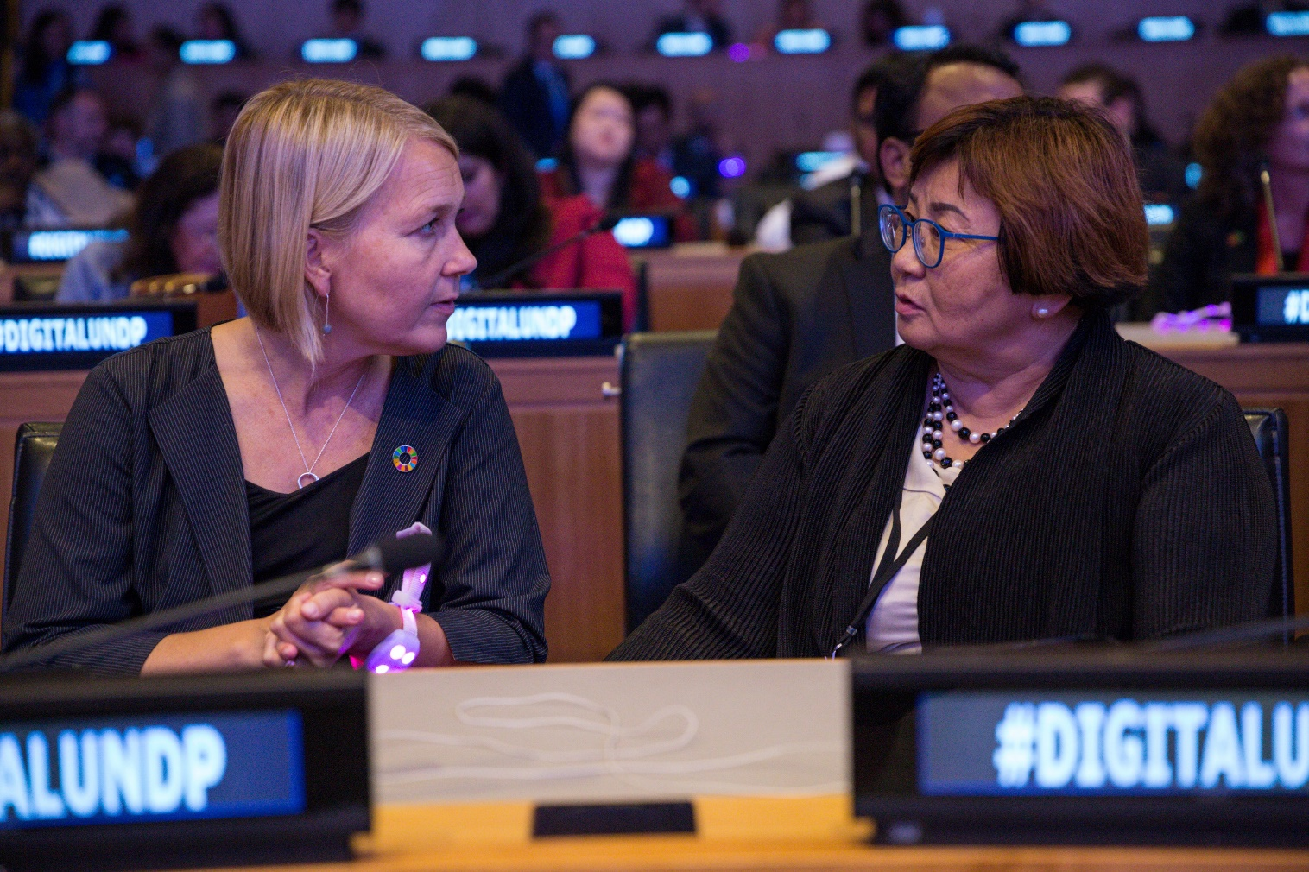
#8 Build relationships and a strong network
Widen your circle of influence

Slide 24
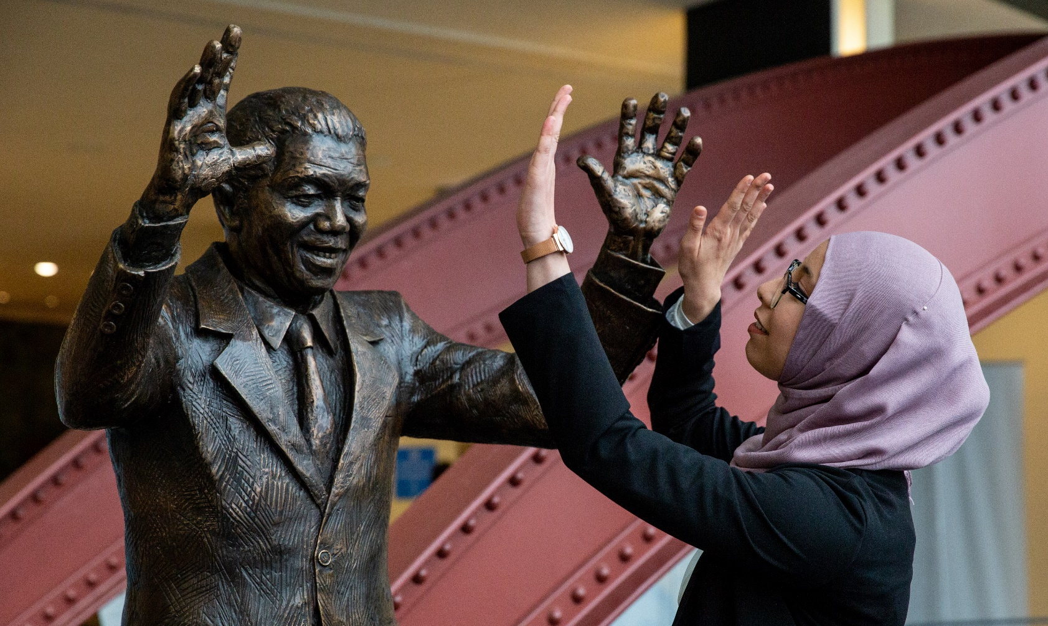
#9 Identify role models
What strategies did they use?

Slide 25
#10 Find a mentor
Mentors will support your efforts and guide you through challenges you face

Slide 26
Reflection
Which of those ideas will you try?

Slide 27
The Challenge Mindset. Shifting your focus from job titles to challenges

Slide 28
Don’t limit yourself

Slide 29
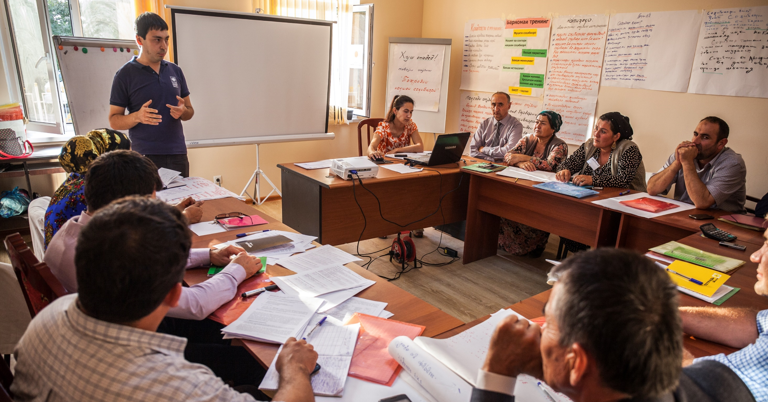
Learning from J.P. Michael
Challenge
Company
People
Knowledge and skills

Slide 30
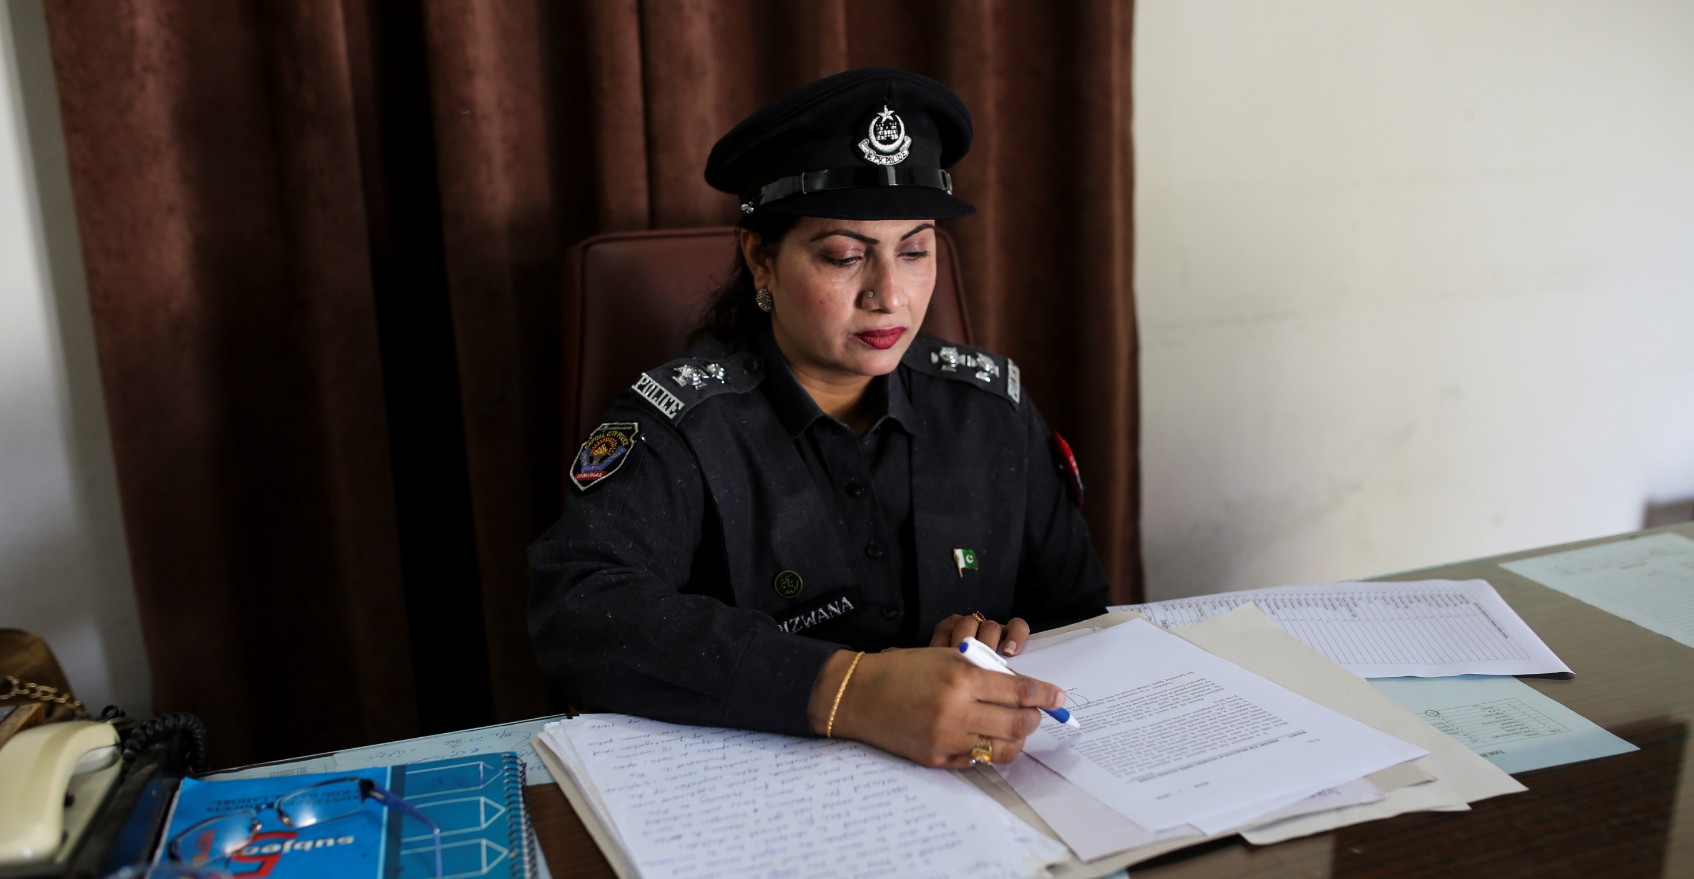
Focus on challenges not job titles

Slide 31
Step 1 : Identify a challenge
Identify a challenge you want to solve
Identify what organization or what part of your organization is working on that

Slide 32
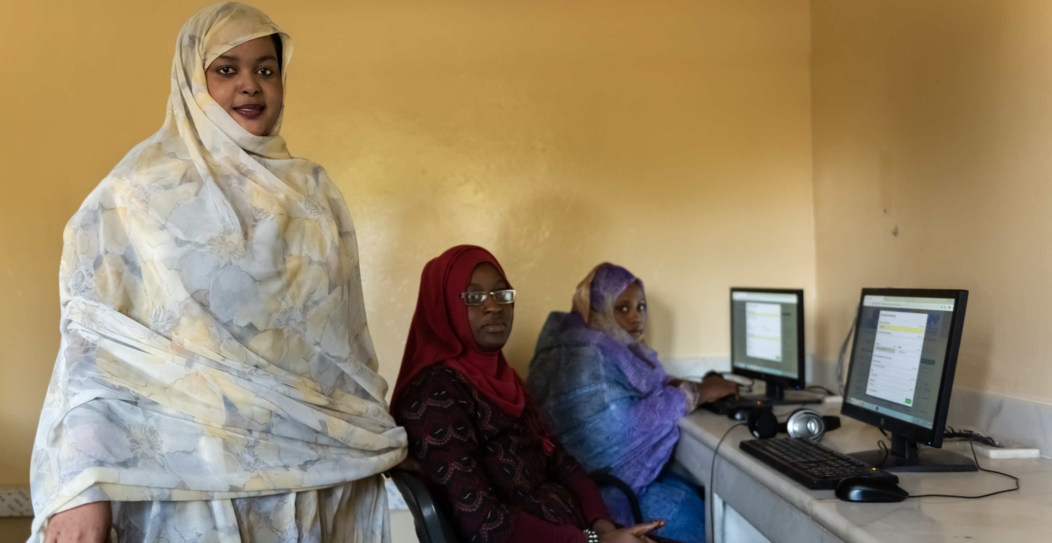
Step 2: Do some research
Online – websites; vision and values; white papers; annual reports; social media; blogs; articles etc.
Offline – people; informal chats; informational interviews

Slide 33
Step 3: Take action
Secondment or specific assignment
Development opportunities
Business plan
Proposal

Slide 34
Reflection
Please share with us a highlight for you from the webinar.
Either…
An Insight – what you learned about career development beyond job titles?
An ‘aha’! – something that really stood out for you
An action – one thing you are going to do because of this webinar
Please type any comments or questions into the chat box.

Slide 35
What remaining questions do you have?

Slide 36
Thank You!
For any further questions, reach out to us on:
E-mail: career.development@undp.org
Yammer: Career Development & Experience
Or visit our intranet page on:
https://undp.sharepoint.com/teams/TalentDevelopmentHub

