Slide 1
Virtual Career Lab
UNDP is Here to Support its People
As highlighted by the Administrator, whether we are at home or in the office, we as UNDP are committed to continue our important work.
Leading yourself and your teams during COVID-19 Pandemic
https://undp.sharepoint.com/teams/TalentDevelopmentHub
Notes:
I will talk to this slide
From Achim: Thank you all for being at work and conducting business with full dedication and commitment despite the increasing challenges of the novel Coronavirus (COVID-19) emergency

Slide 2
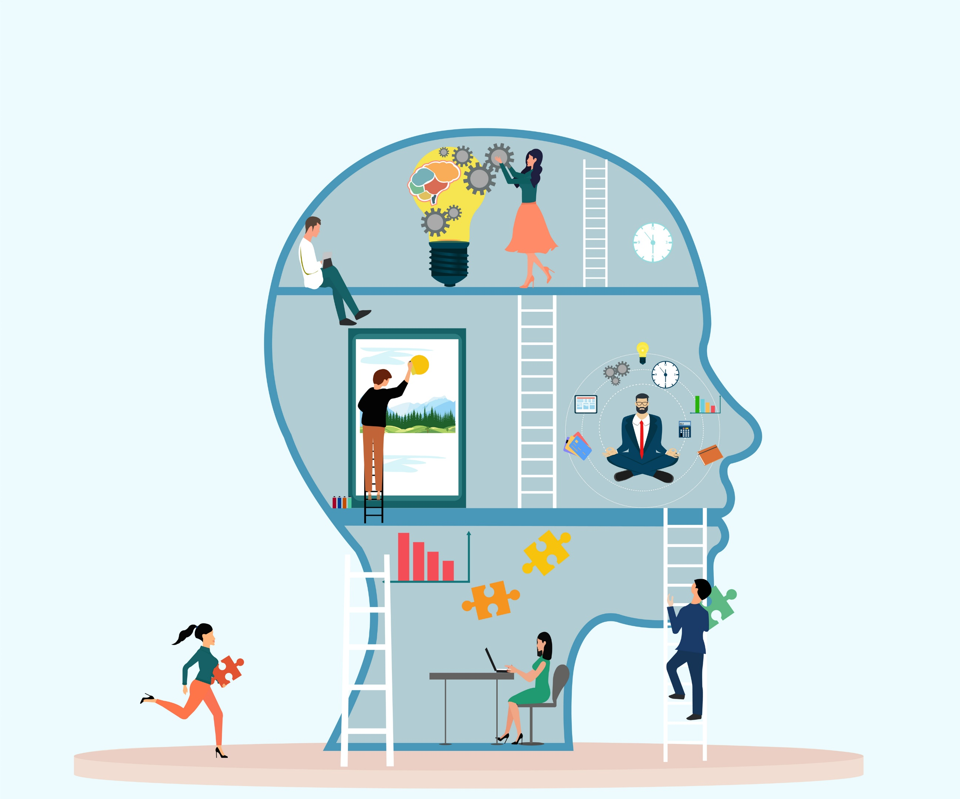
How
Emotional Intelligence
is Critical to
Career Success

Slide 3
Your Hosts
for Today…
Betty Almonte
Career Development & Experience Analyst
UNDP - Copenhagen
Amy Centers, Ph.D., PCC
Vice President of
Career Transformation Solutions
Fuel50

Slide 4
What is Emotional Intelligence (EQ)?
Why is EQ important?
EQ and Career Success
The Four Components of EQ
How to Strengthen Your EQ
Questions
Key Takeaways

Slide 5
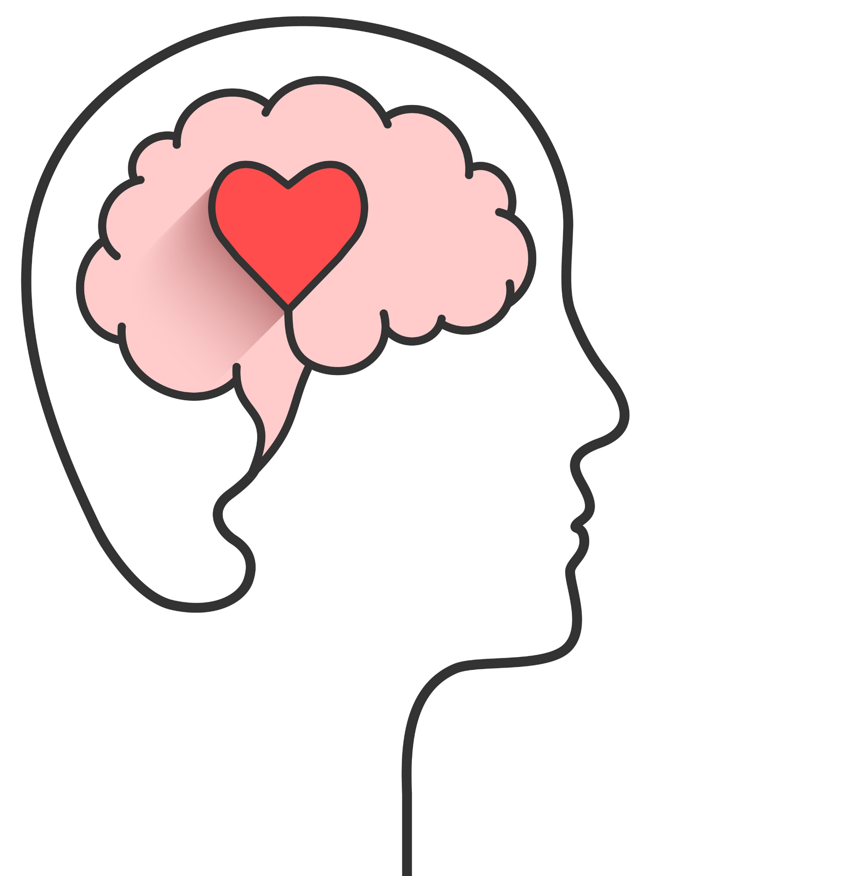
“It is very important to understand that emotional intelligence is not the opposite of intelligence, it is not the triumph of heart over head – it is the unique intersection of both.”
- DAVID CARUSO
Source: https://quotefancy.com/quote/1619519/David-Caruso-It-is-very-important-to-understand-that-emotional-intelligence-is-not-the

Slide 6
What Do You Think?
What % of employees say when a colleague doesn't control their emotions, it affects their perception of that person's level of professionalism.
86%
54%
35%
Source: https://www.prnewswire.com/news-releases/why-you-need-emotional-intelligence-at-work-300412310.html
Notes:
Answer: A 86%

Slide 7
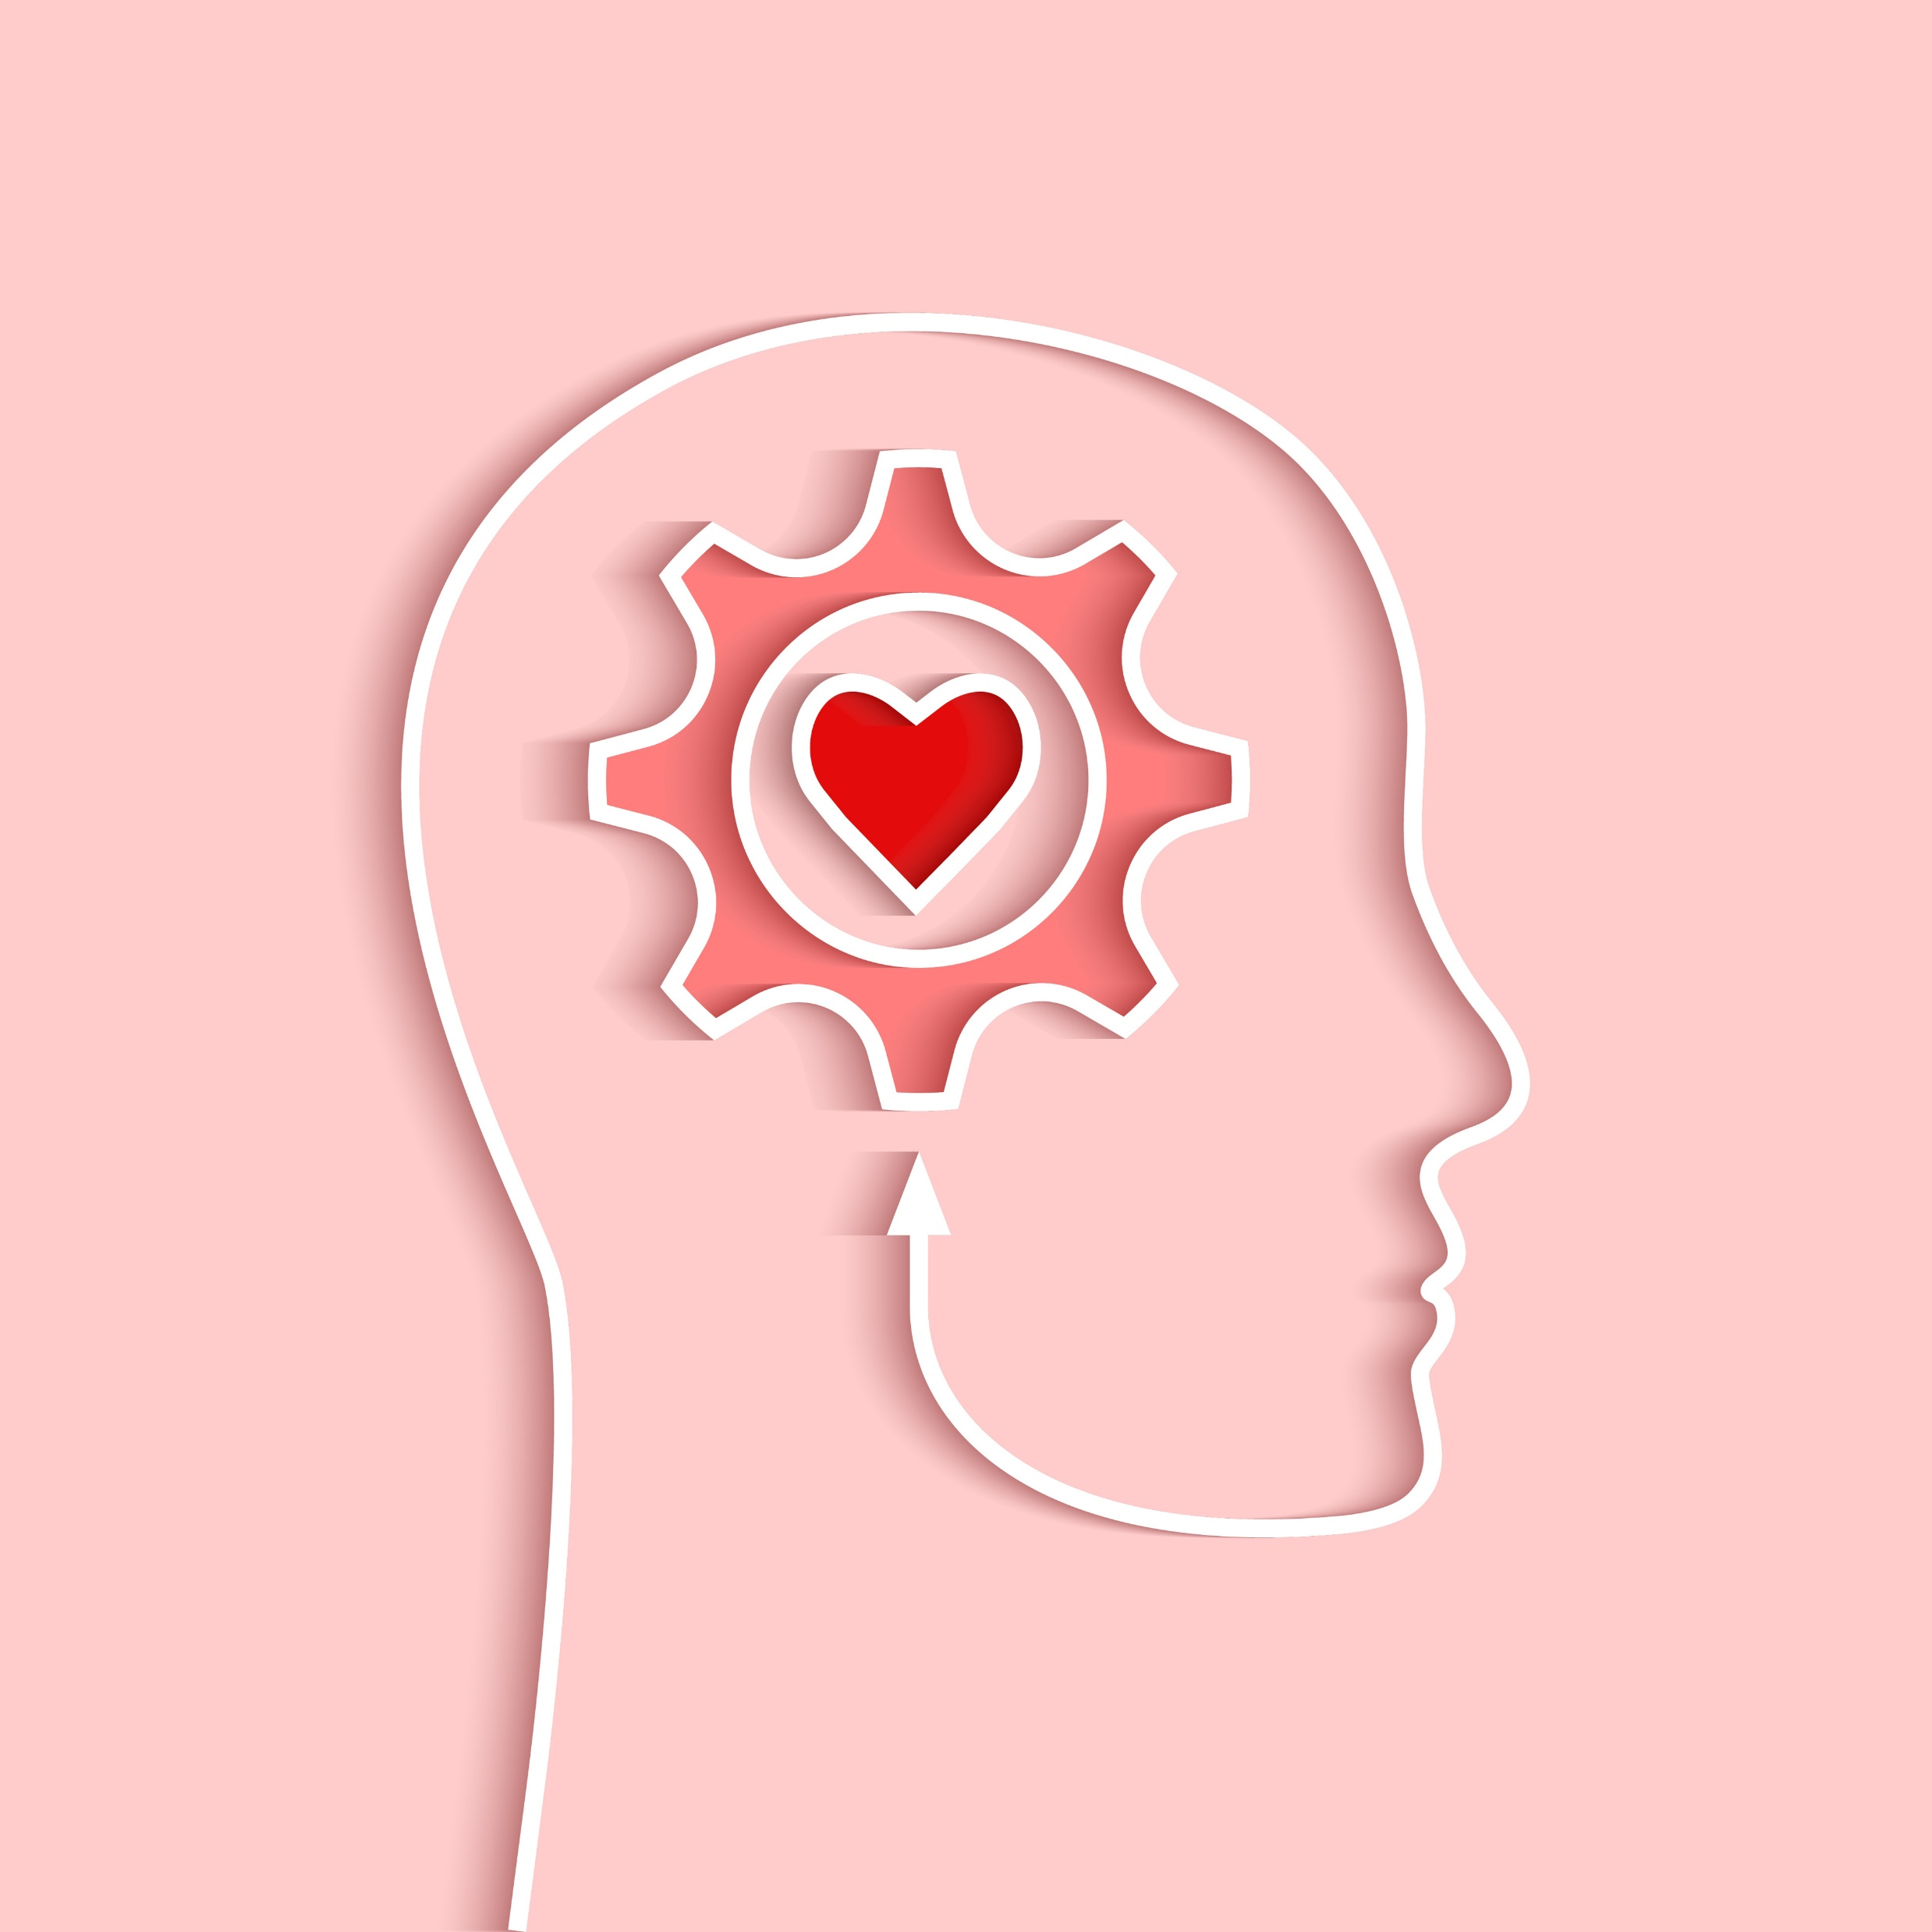
What is Emotional Intelligence (EQ)?
We define Emotional Intelligence (or EQ) as the ability to:
Recognize, understand and manage our own emotions
Recognize, understand and influence the emotions of others
Source: https://www.ihhp.com/meaning-of-emotional-intelligence/
Notes:
In practical terms, this means being aware that emotions can drive our behavior and impact people (positively and negatively), and learning how to manage those emotions – both our own and others.
Managing emotions is especially important in situations when we are under pressure. For example, when we are…
Giving and receiving feedback
Meeting tight deadlines
Dealing with challenging relationships
Not having enough resources
Navigating change
Working through setbacks and failure

Slide 8
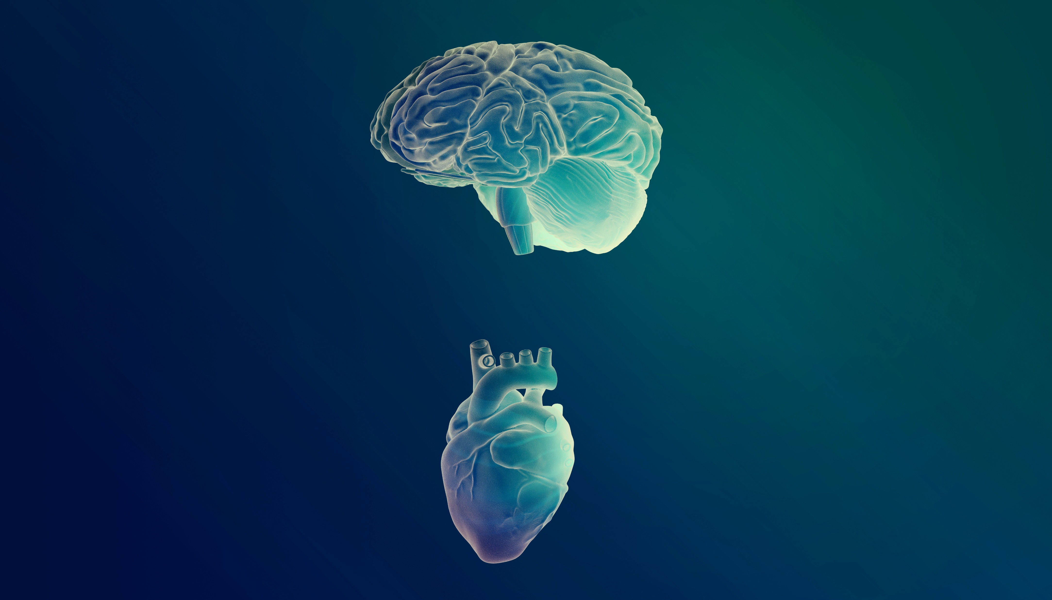
At a personal level, emotional intelligence helps us:
Have uncomfortable conversations without hurting feelings
Manage our emotions when stressed or feeling overwhelmed
Improve relationships with the people we care about
At work, emotional intelligence can help us:
Resolve conflicts
Coach and motivate others
Create a culture of collaboration
Build psychological safety within teams
Why is EQ Important?
Sources: https://www.ihhp.com/meaning-of-emotional-intelligence/
https://www.weforum.org/agenda/2020/02/emotional-intelligence-career-life-personal-development/
Source: https://www.ihhp.com/meaning-of-emotional-intelligence/
Notes:
Emotional intelligence (EQ) is the “something” in each of us that is a bit intangible. It affects how we manage behavior, navigate social complexities, and make personal decisions that achieve positive results. Emotional intelligence is your ability to recognize and understand emotions in yourself and others, and your ability to use this awareness to manage your behavior and relationships.
It’s a scientific fact that emotions precede thought. When emotions run high, they change the way our brains function…diminishing our cognitive abilities, decision-making powers, and even interpersonal skills. Understanding and managing our emotions (and the emotions of others) helps us to be more successful in both our personal and professional lives.

Slide 9
Top 10 Skills in the 2020’s
Complex Problem Solving
Critical Thinking
Creativity
People Management
Coordinating with Others
Emotional Intelligence
Judgement and Decision Making
Service Orientation
Negotiation
Cognitive Flexibility
Emotional Intelligence is a UNDP People Manager competency and one of the
World Economic Forum's
Top 10 skills needed for success in the 2020’s
Source: The 10 Skills You Need to Thrive in the Fourth Industrial Revolution, World Economic Forum

Slide 10
EQ and
Career Success
How Can You Support
Peak Performance?
Source: www.flexjobs.com/blog/post/ways-emotional-intelligence-key-workplace-success/
https://www.weforum.org/agenda/2017/02/why-you-need-emotional-intelligence/
Notes:
What Is Emotional Intelligence in the Workplace?
Emotional intelligence consists of three main components:
Accurately identifying your emotions and the emotions of others.
Managing emotions, which includes controlling your emotions and the ability to influence others’ emotions (like calming them down or cheering them up).
Using emotions and applying them to tasks like thinking and problem-solving.
Employees who possess these abilities generally have higher emotional intelligence. And those with higher emotional intelligence tend to be more successful at work because they are better able to:
Solve problems
Keep cool under pressure
Resolve conflicts
Listen, reflect, and respond to constructive criticism
In fact, one survey found emotional intelligence is the strongest predictor of high performance, with 90% of top performers ranking high in emotional intelligence.
ow much of an impact does emotional intelligence have on your professional success? The short answer is: a lot! It’s a powerful way to focus your energy in one direction with a tremendous result. TalentSmart tested emotional intelligence alongside 33 other important workplace skills, and found that emotional intelligence is the strongest predictor of performance, explaining a full 58% of success in all types of jobs.
Your emotional intelligence is the foundation for a host of critical skills—it impacts most everything you do and say each day.
Of all the people we’ve studied at work, we've found that 90% of top performers are also high in emotional intelligence. On the flip side, just 20% of bottom performers are high in emotional intelligence. You can be a top performer without emotional intelligence, but the chances are slim.
Naturally, people with a high degree of emotional intelligence make more money—an average of $29,000 more per year than people with a low degree of emotional intelligence. The link between emotional intelligence and earnings is so direct that every point increase in emotional intelligence adds $1,300 to an annual salary. These findings hold true for people in all industries, at all levels, in every region of the world. We haven’t yet been able to find a job in which performance and pay aren’t tied closely to emotional intelligence.
Using Emotional Intelligence for Professional Success
Using your emotional intelligence can help you attain workplace success. Here’s how.
1. Helps You Be Self-Motivated
Individuals with high levels of emotional intelligence tend to be self-motivated. The primary force behind their motivation is not title or money. What drives emotionally intelligent people is their intrinsic motivation—a sense of ambition.
These individuals possess the self-drive to achieve and improve, readiness to act on opportunities, a commitment to personal and organizational goals, and the capability to stay positive and keep on going in the face of setbacks.
2. Increases Self-Awareness
Self-awareness is the cornerstone of emotional intelligence and is also influential in our personal and organizational growth. Studies have found that employees with high emotional intelligence tend to be much more self-aware.
They understand and realize how their actions can affect other colleagues. Their performance is not affected by their resentment or grievance. They take feedback and criticism positively and are typically ready to learn from their mistakes.
3. Boosts Positivity
A high level of emotional intelligence empowers positivity. Employees with a positive attitude don’t hide from arduous endeavors, and they consider failure a learning opportunity.
A positive attitude enables you to be more creative, resourceful, flexible, and open-minded.
4. Increases Empathy
Empathy among employees leads to stronger relationships, mutual respect, trust, and openness. It helps you have a better understanding of your colleague’s situation, actively listen, and act accordingly. Empathy enables everyone to operate better as a team, connect with colleagues, and genuinely work together to achieve their common organizational goals.
5. Helps You Embrace Change
Individuals with high levels of emotional intelligence don’t run away in the face of change—they typically embrace it. They understand and accept that change is the only constant in life.
They’re also able to effectively and efficiently handle the psychological challenges associated with change. They’re able to manage several diverse demands from their stakeholders and shift priorities with ease.

Slide 11
Technical Skills
10%
How Can You Support
Peak Performance?
IQ
10%
EQ distinguishes exceptional leaders
Emotional Intelligence 80%
of the defining characteristics of exceptional and unexceptional leaders were Emotional Intelligence behaviors
Sources: Institute for Heath and Human Potential, What we’ve learned from 20 years of asking people about exceptional leaders, 2019
https://www.weforum.org/agenda/2020/02/emotional-intelligence-career-life-personal-development/
Notes:
Decades of research now point to emotional intelligence as the critical factor that sets star performers apart from the rest of the pack. It’s a powerful way to focus your energy in one direction with a tremendous result. TalentSmart tested emotional intelligence alongside 33 other important workplace skills, and found that emotional intelligence is the strongest predictor of performance, explaining a full 58% of success in all types of jobs.
Of all the people we’ve studied at work, we've found that 90% of top performers are also high in emotional intelligence. On the flip side, just 20% of bottom performers are high in emotional intelligence. You can be a top performer without emotional intelligence, but the chances are slim.
Naturally, people with a high degree of emotional intelligence make more money—an average of $29,000 more per year than people with a low degree of emotional intelligence. The link between emotional intelligence and earnings is so direct that every point increase in emotional intelligence adds $1,300 to an annual salary. These findings hold true for people in all industries, at all levels, in every region of the world. We haven’t yet been able to find a job in which performance and pay aren’t tied closely to emotional intelligence.

Slide 12
SELF-AWARENESS
SELF-MANAGEMENT
The four components
of EQ
SOCIAL-AWARENESS
RELATIONSHIP-MANAGEMENT
Source: Institute for Heath and Human Potential, What we’ve learned from 20 years of asking people about exceptional leaders, 2019

Slide 13
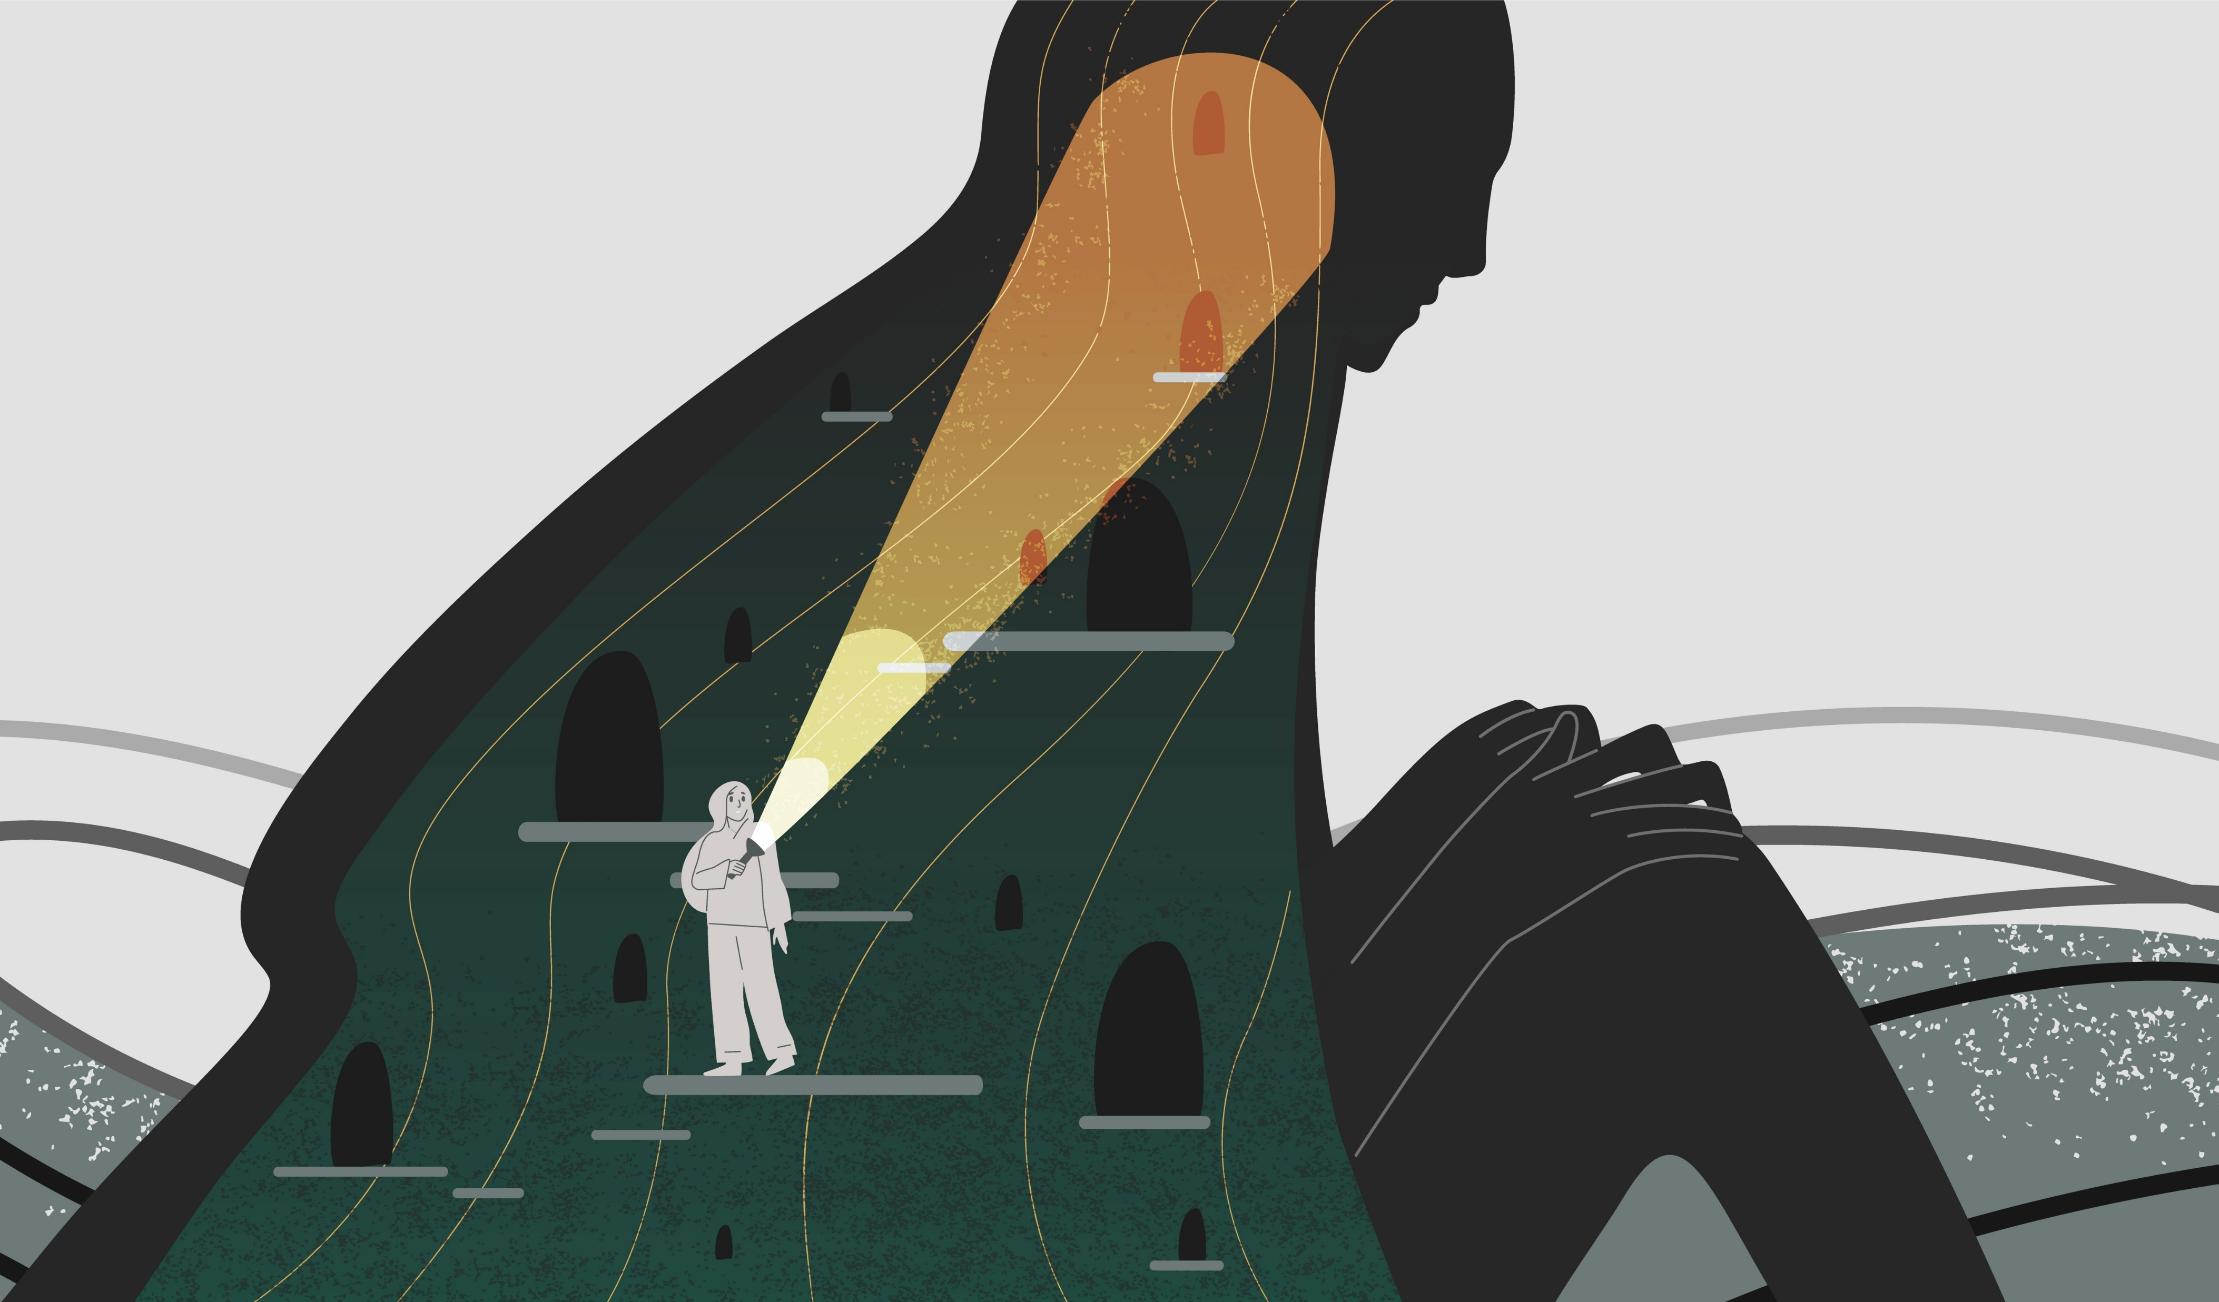
Self-Awareness
How aware are you of your emotions in the moment?
Source: https://www.hrzone.com/perform/people/emotional-intelligence-do-you-know-the-four-basic-components
Notes:
Self-awareness
This is considered the foundation for all the other components of emotional intelligence. Self-awareness means being aware of what you are feeling; being conscious of the emotions within yourself.
People who are in touch with their emotions are better able to guide their own lives. Team members need to be in touch with their emotions to interact effectively and appreciate emotions in others.
Those with high levels of self-awareness learn to trust their ‘gut feelings’ and realise that these feelings can provide useful information about difficult decisions. Answers are not always clear regarding who is at fault when problems arise. In these situations, team members have to rely on their own feelings and intuition.
Refer colleagues to “Know Yourself” section on the TDU Site for further exploration.

Slide 14
Self-Management
You may be aware of your emotions, but can you also self-regulate to be responsive instead of reactive?
Source: https://www.hrzone.com/perform/people/emotional-intelligence-do-you-know-the-four-basic-components
Notes:
Self-management
This is the second key component of emotional intelligence in managing emotions. Operationally it means that team members need to be able to balance their own moods so that worry, anxiety, fear or anger do not get in the way of what needs to be done.
Those who can manage their emotions perform better because they are able to think clearly. Managing emotions does not mean suppressing or denying them but understanding them and using that understanding to deal with situations productively. Team members should first recognise a mood or feeling, think about what it means and how it affects them, and then choose how to act.

Slide 15
Social-Awareness
Can you read the room?
Look at situations from multiple perspectives?
Intuit what is happening beneath the surface?
Source: https://www.hrzone.com/perform/people/emotional-intelligence-do-you-know-the-four-basic-components
Notes:
Social awareness
Being socially aware means that you understand how to react to different social situations, and effectively modify your interactions with other people so that you can achieve the best results.
It also means being aware of the world around you and how different environments influence people. Increasing social awareness means improving your skills to connect with others verbally, nonverbally and in the community.

Slide 16
Relationship-Management
Do you have a network of trusted relationships?
Do people know, like, and want to work with you?
Source: https://www.hrzone.com/perform/people/emotional-intelligence-do-you-know-the-four-basic-components
Notes:
Relationship management
The final component of emotional intelligence is the ability to connect with others, build positive relationships, respond to the emotions of others and influence others on the team.
Relationship management includes the identification, analysis and management of relationships with people inside and outside of your team as well as their development. It is also vital in negotiating successfully, resolving conflicts and working with others toward a shared goal.

Slide 17
EQ
Unlike IQ and personality, EQ can be changed.
IQ
PERSONALITY
Sources: Institute for Heath and Human Potential, What we’ve learned from 20 years of asking people about exceptional leaders, 2019
https://www.weforum.org/agenda/2017/02/why-you-need-emotional-intelligence/
Notes:
Emotional intelligence taps into a fundamental element of human behavior that is distinct from your intellect. There is no known connection between IQ and emotional intelligence; you simply can’t predict emotional intelligence based on how smart someone is. Intelligence is your ability to learn, and it’s the same at age 15 as it is at age 50. Emotional intelligence, on the other hand, is a flexible set of skills that can be acquired and improved with practice. Although some people are naturally more emotionally intelligent than others, you can develop high emotional intelligence even if you aren’t born with it.
Personality is the final piece of the puzzle. It’s the stable “style” that defines each of us. Personality is the result of hard-wired preferences, such as the inclination toward introversion or extroversion. However, like IQ, personality can’t be used to predict emotional intelligence. Also like IQ, personality is stable over a lifetime and doesn’t change. IQ, emotional intelligence, and personality each cover unique ground and help to explain what makes a person tick.

Slide 18
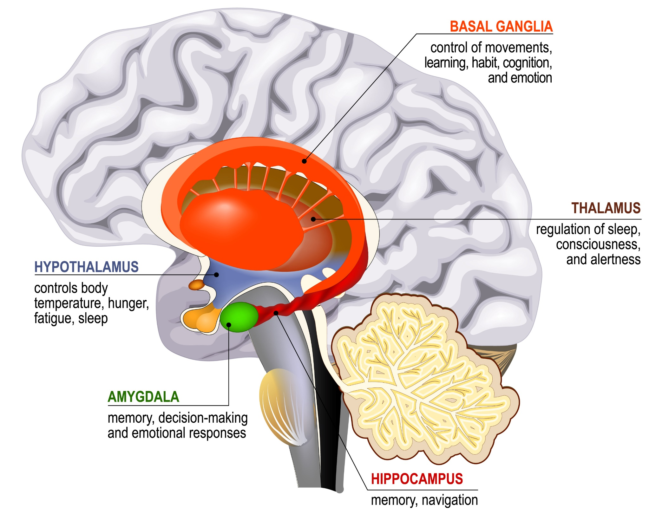
Limbic System
Pre-frontal
Cortex
The to EQ is rooted in brain science
10 SECONDS
Sources: Institute for Heath and Human Potential, What we’ve learned from 20 years of asking people about exceptional leaders, 2019
https://www.verywellmind.com/what-happens-during-an-amygdala-hijack-4165944
Notes:
Have you ever lost control of your emotions and did something in the heat of the moment that you later regretted? Perhaps you've "lost it" or blown up at someone—your partner or child, work colleague, or perhaps the driver of another car—to such a degree that later, you realized was uncalled for.
If your answer is yes, then you've probably been hijacked by your amygdala.
Overview
The term "amygdala hijacking" was first used by psychologist Daniel Goleman in his 1995 book, "Emotional Intelligence: Why It Can Matter More Than IQ" to refer to an immediate and intense emotional reaction that's out of proportion to the situation. In other words, it's when someone "loses it" or seriously overreacts to something or someone.
Goleman's term aims to recognize that we have an ancient structure in our brain, the amygdala, that is designed to respond swiftly to a threat.
While the amygdala is intended to protect us from danger, it can interfere with our functioning in the modern world where threats are often more subtle in nature.
Causes
When you see, hear, touch, or taste something, that sensory information first heads to the thalamus, which acts as your brain's relay station. The thalamus then relays that information to the neocortex (the “thinking brain”). From there, it is sent to the amygdala (the “emotional brain”) which produces the appropriate emotional response.
However, when faced with a threatening situation, the thalamus sends sensory information to both the amygdala and the neocortex. If the amygdala senses danger, it makes a split-second decision to initiate the fight-or-flight response before the neocortex has time to overrule it.
This cascade of events triggers the release of stress hormones, including the hormones epinephrine (also known as adrenaline) and cortisol.
These hormones prepare your body to flee or flight by increasing your heart rate, elevating your blood pressure, and boosting your energy levels, among other things.
While many of the threats we face today are symbolic, evolutionarily, our brains evolved to deal with physical threats to our survival that required a quick response. As a result, our body still responds with biological changes that prepare us to fight or flight, even though there is no actual physical threat with which we must contend.
Mental Health and the Amygdala
Chronic stress and certain mental health conditions can also play a role in the functioning of fear circuitry in the brain, which can result in greater chances of amygdala hijacking.
People with post-traumatic stress disorder (PTSD), for example, show greater amygdala activation and therefore, increased emotional responding including fear and anxiety responses.
People with other anxiety disorders, such as social anxiety disorder (SAD) and panic disorder may also respond more strongly in their amygdala.
Even without a diagnosis of PTSD or anxiety disorder, chronic stress can lead to an overactive fear and anxiety circuit in your brain, which also reduces the functioning of other areas of the brain that help with inhibition of fear, such as the hippocampus and medial prefrontal cortex.
All of this means that chronic stress can trigger more frequent amygdala hijacks and even subsequent problems with short-term memory, which is why it is important to work on understanding and taking charge of your emotional reactions. One way to do this is through preventative work.
Learning coping mechanisms and planning ahead can positively influence how you will respond in times of stress and help avoid an amygdala-induced overreaction.
Prevention
The best way to prevent an amygdala hijack is to increase your emotional intelligence. Emotional intelligence describes your ability to understand and manage your emotions and use this information in positive ways to relieve stress, communicate effectively, empathize with others, and defuse conflict.
A person who is emotionally intelligent has strong connections between the emotional center of the brain and the executive (thinking) center.
Emotionally intelligent people know how to de-escalate their own emotions by becoming engaged, focused, and attentive to their thoughts and feelings.
Although some people are naturally more emotionally intelligent than others, like many skill sets, emotional intelligence can be cultivated. One way is by practicing mindfulness.
Mindfulness
Mindfulness is the ability to be fully present, aware of where you are and what you're doing, and not overly reactive or overwhelmed by what's going on around you. According to a 2014 study, mindfulness meditation can help improve your emotional intelligence in three major ways:
Mindfulness is the ability to be fully present, aware of where you are and what you're doing, and not overly reactive or overwhelmed by what's going on around you. According to a 2014 study, mindfulness meditation can help improve your emotional intelligence in three major ways:⁴
﻿
Improves your ability to comprehend your own emotions
Helps you learn how to recognize the emotions of others
Strengthens your ability to control your emotions
By practicing mindfulness every day, you will develop this part of your brain and make it stronger. Then, when you find yourself in a stressful situation, it will be easier to switch on the mindful part of your mind.⁵﻿ If you still find yourself having trouble with this concept, try keeping notes throughout the day about situations that cause you to feel strong emotions.
Stress Management
Another key to preventing amygdala hijacking is being aware of your stressors and identifying when acute, everyday stress has turned into chronic stress. If you find yourself constantly in a state of stress, employing stress management techniques can help.
Effective stress management should include fast-acting stress relievers (like breathing exercises) for immediate relief in stressful situations as well as healthy habits that reduce overall stress (like exercise, meditation, and journaling).
Coping
Though very effective in preventing amygdala hijacks, it can take time to learn and incorporate mindfulness and stress management into your daily routine. If despite your best efforts at prevention, you find yourself in the middle of a hijack, there are a number of things you can do to quickly get your unwanted emotions under control:
Name it. Notice when you've been triggered and identify what's triggering you. Notice changes in your tone, tightness in your chest or stomach, clenching in your jaw or hands, etc. In these moments, say to yourself, "I'm feeling triggered right now.“
Remember the 10-second rule. It takes the chemicals that are released during the amygdala hijacking about 10 seconds to dissipate. Using this time to focus on something pleasant will prevent your amygdala from taking control and causing an emotional reaction
Breathe. Become aware of your breath and slow it down. When you slow down your breathing and make it rhythmic, you activate the parasympathetic nervous system which is your rest response. This type of deep breathing calms down your nervous system and allows you to make thoughtful decisions in stressful times.
Draw on mindfulness. Look around you and notice things in the environment. This will help you to move out of your head and back into the present.
Take a timeout. If you are truly feeling out of control, excuse yourself from the situation you are in to get a hold of your emotions.
While preventing an overreaction in the first place or diffusing it in the moment may be the ultimate goal, it's OK to slip up. If you do find yourself in the aftermath of a full-blown amygdala hijack, take some time to acknowledge your actions and review what happened.
Spending some time thinking about your reactions—especially when they aren't a reflection of your best self—can help to shift you toward a mindful way of viewing your experience. Over time, this practice will help to develop your emotional intelligence as well.

Slide 19
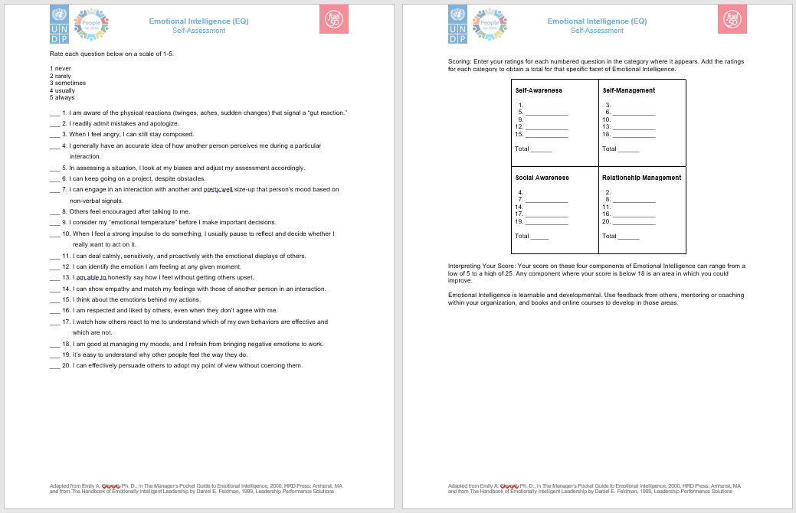
How to
strengthen
your EQ
Take the EQ self-assessment
Keep track of your feelings
Learn what triggers you
Practice responding vs. reacting
Take responsibility for your feelings
Practice active listening
Look at yourself objectively
Be open to feedback
Know your stressors
Keep a journal
Source: https://thezeroed.com/behaviours-that-helps-improve-emotional-intelligence/
Notes:
You don’t have to worry on whether you have low or high emotional intelligence. I have a compiled this list of over 9 behaviours that you can adopt to help improve emotional intelligence.
Keep Track of Your Feelings
How many times during the day do you stop everything you are doing and just take a deep breath?
Most of the day we are busy and live a hectic lifestyle. It is very easy to lose track of your feelings and emotions. It is important to center ourselves at least once in 2 hours.
Centering yourself is quite easy, all you need to do is perform some easy breathing exercises. You can perform a quick and effective exercise in 60 seconds. Breathing exercises would help relax your nerves and give you better control of your emotions.
Learn what Triggers your Emotions
While learning how to improve emotional intelligence, you should also try to understand the kind of things that triggers your emotions.
When you are conscious of what can get you angry, it would be easier for you to avoid such instances. You would also know how to react when faced with situations that would normally make you uncomfortable since you already prepared for it.
Respond Instead of Reacting During Conflict
It is very normal to face instances of conflict as you go about your daily tasks. It is also normal to have outbursts of anger during conflict, but it isn’t the best approach.
Emotional intelligent people make an effort to stay calm during times of crisis. They ensure that they do not act impulsively.
An emotional intelligent individual understands that the main goal during conflict is finding a suitable resolution for both parties. So all their actions and emotions are geared toward reaching this goal in an amicable manner.
Be Responsible For your Feelings
You have to accept that you are in charge of your feelings. Your emotions and behavior comes directly from you. It is not hereditary. The moment you accept that and stop blaming others for your action or reactions, you are a step closer to becoming more emotionally intelligent.
Improve your Listening Skills
An emotional intelligent individual listens to understand instead of just waiting for their turn to speak. Before speaking they ensure that they understand what message the person they are in conversation with is trying to relay.
Not only do they listen to words, they are also pay attention to the non verbal aspects of the conversation.
Look at Yourself Objectively
This might be quite difficult for you to do on your own. Majority of the time we would be bias in the analysis of ourselves and characters.
You would need the input of your friends and family. Ask them what they think your weaknesses are. Write them down and work on improving them.
Compare what they tell you and the perception that you already have about yourself. This way you know what areas to improve.
Be open to feedback
An important behaviour to develop that can help improve emotional intelligence is learning how to take criticism well.
People with high emotional intelligence would try to understand where the critique is coming from instead of getting angry or offended immediately. After this, they find constructive ways to find a solution to these issues.
They see constructive criticisms as an avenue to improve on themselves.
Know your stressors
Know the things that stresses you out and take a proactive step to reduce or entirely get rid of these stressors where it is possible.
If you know that going to work without eating in the morning destablizes you, make an effort to wake up early in the morning to prepare breakfast before going to work.
An important stressor that most people don’t realize is lack of sleep. Inadequate sleep can have tremendous effects on your emotions.
Keep a Journal
A journal is a good way to keep track of things that occurred during the day. Documenting your activities during the day would help you highlight what you are doing, your emotional state and also pinpoint areas that gives you problems.
You would also be able to keep track of trends, understand your stressors better and improve the quality of your life in the process.

Slide 20
What Will You Do?
What is one thing you can start doing to increase your EQ?
(Write your responses in the chat box)

Slide 21
Questions?

Slide 22
What is one
key takeaway
from today’s session?
(Write your responses in the chat box)

Slide 23
Thank You!
For any further questions, please reach out to us via:
E-mail: career.development@undp.org
Yammer: Career Development & Experience
Or visit our intranet page at:
https://undp.sharepoint.com/teams/TalentDevelopmentHub

